Slide 1

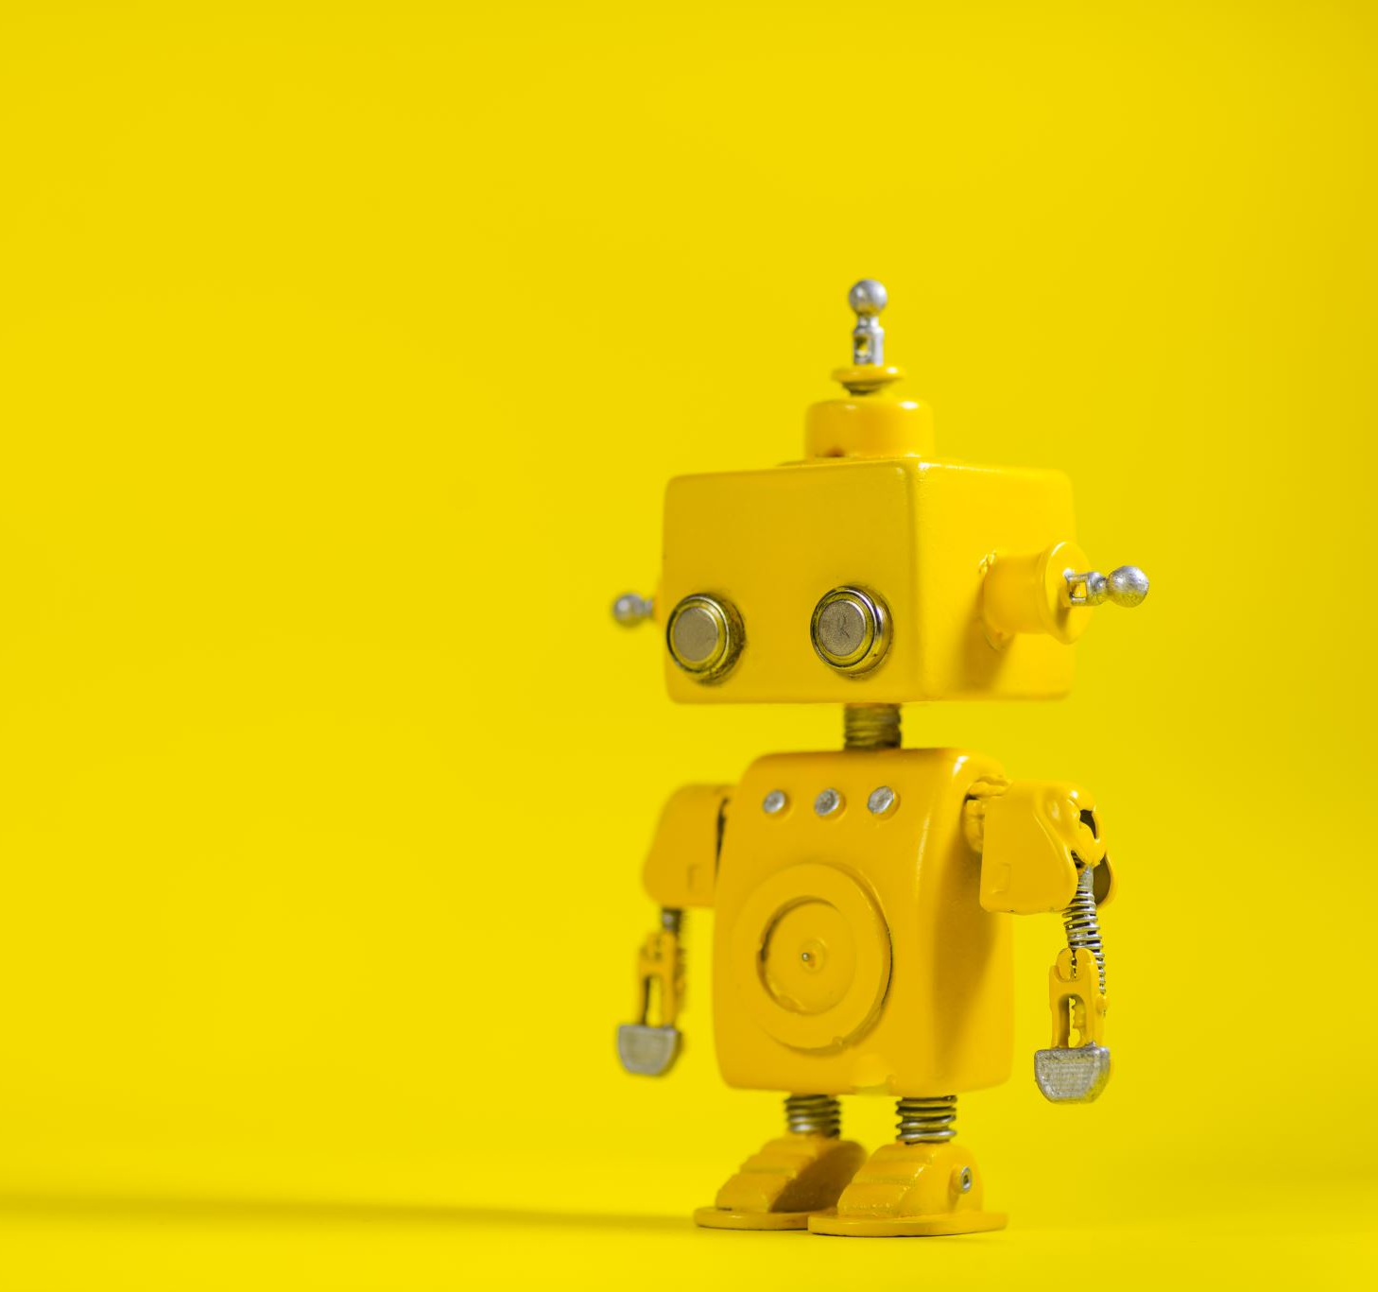
Detection and Diagnosis of Mental Health- The AI Approach DR PRAVEEL LALWANI | DR SUMIT MITTAL
Engineering Project in Community Service (DSN3099)

Slide 2
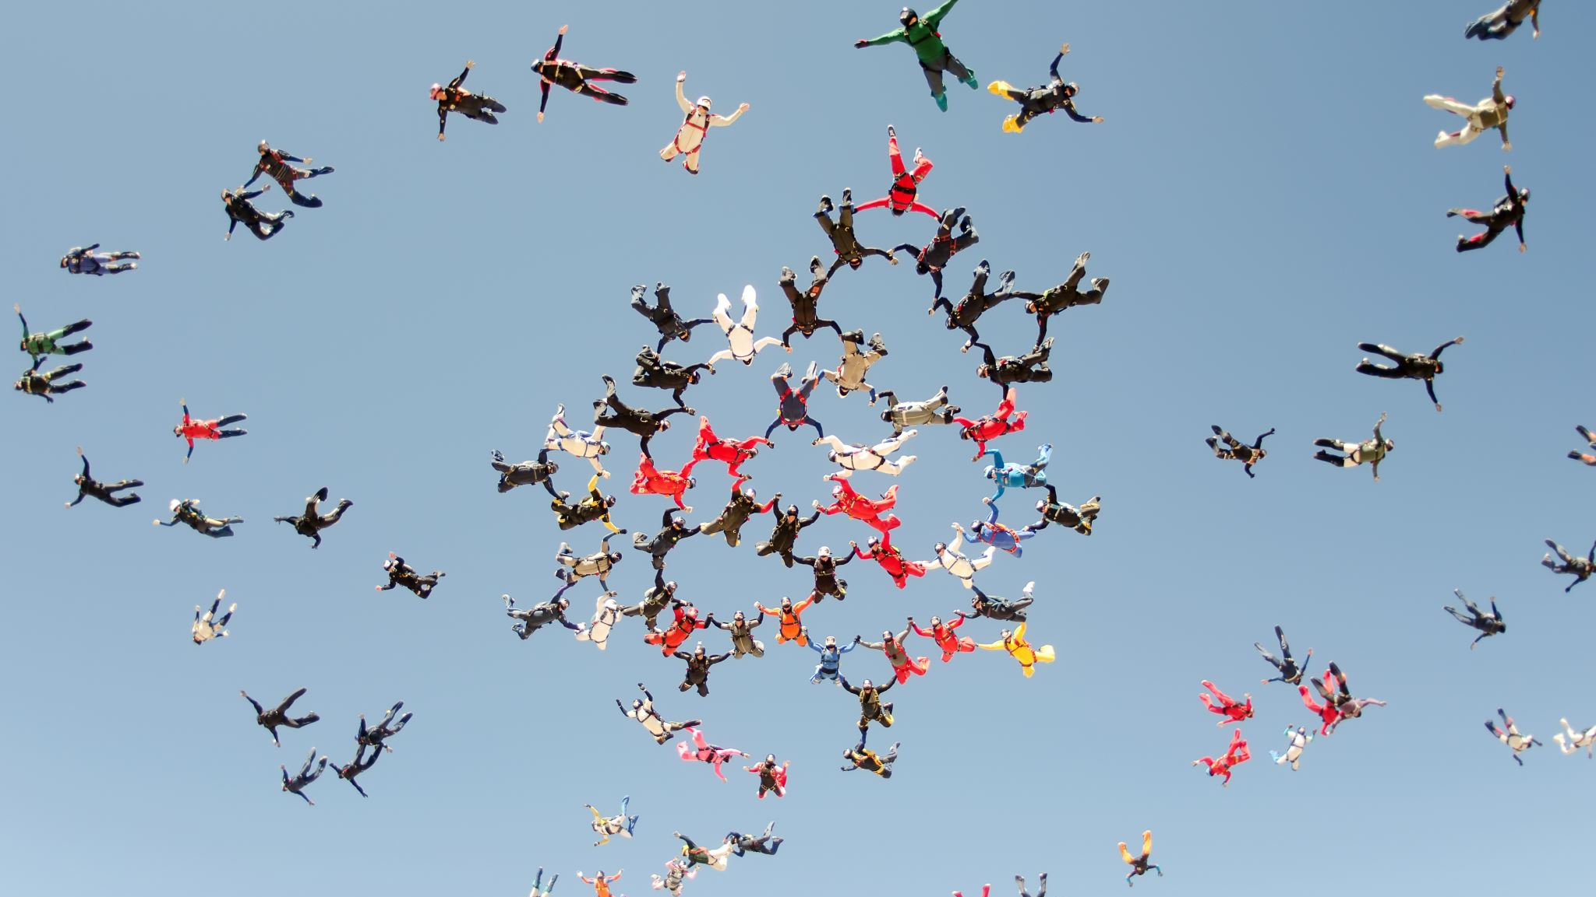
Team Members

Slide 3
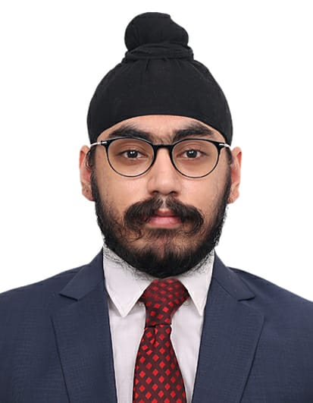
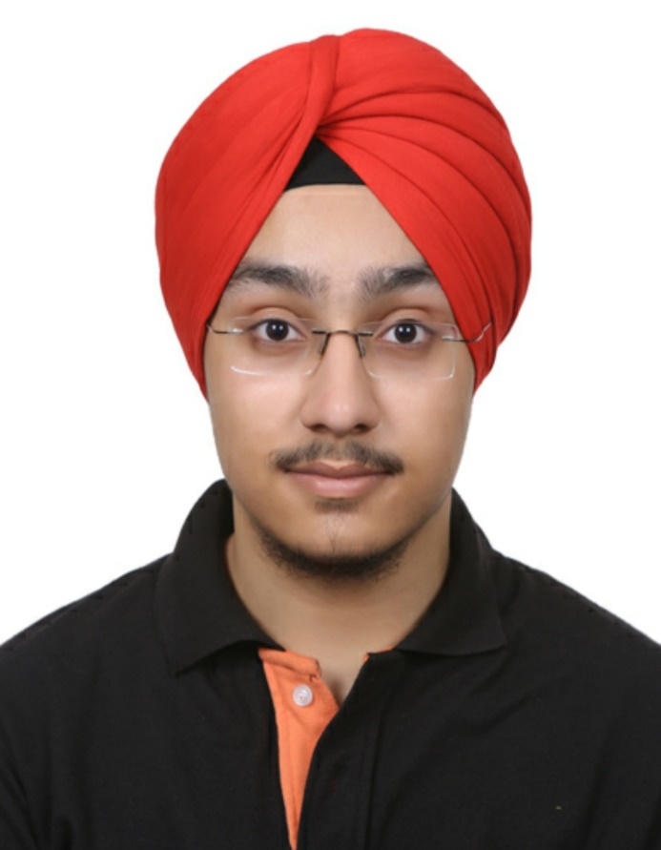
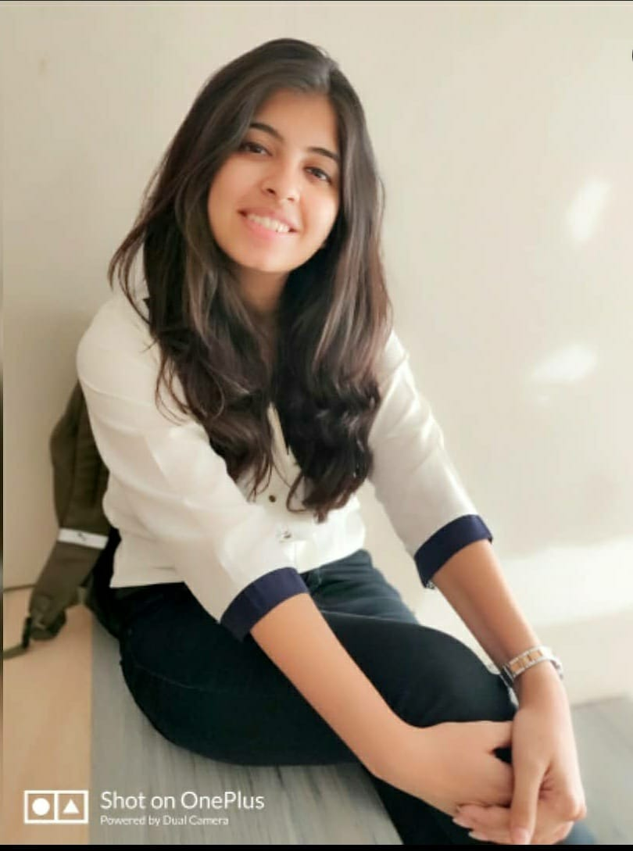
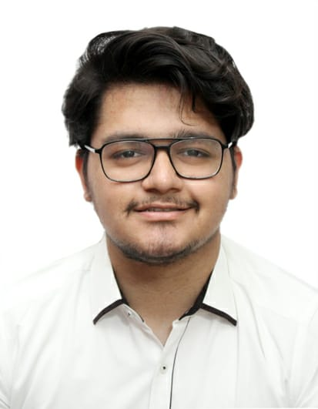
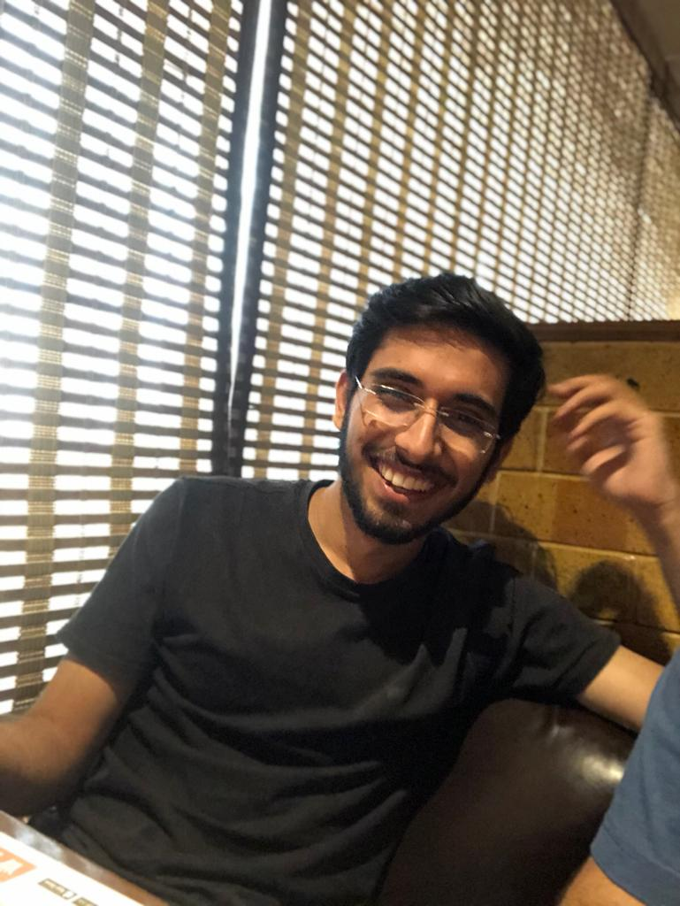
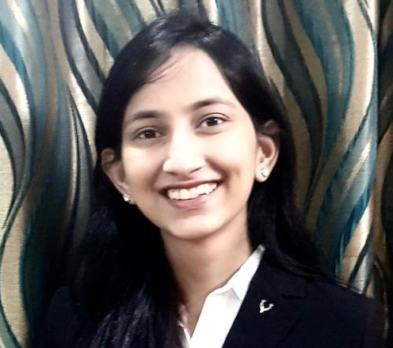
18BCE10105 - GURSIMAR SINGH BEDI
18BCE10125 - JASROOP SINGH
18BCE10178 – NISHTHA BHATIJA
18BCE10179 – NIVESH AHUJA
18BCE10314 - PRATYUSH SETHI
18BCE10318 - SNEHAL KAMAL

Slide 4
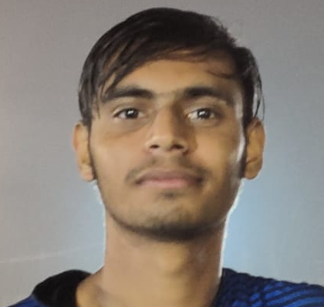
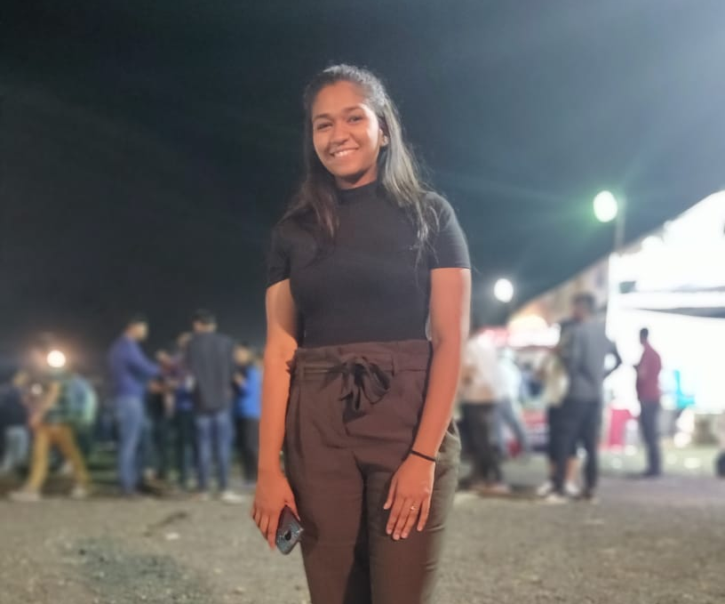
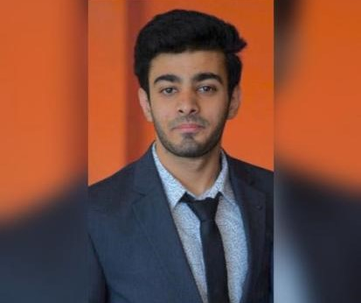
18BCG10041 - DHRUV NANDAN
18BCY10011 - AKSHIT SHARMA
18BCY10102 - SPRIHA CHOUDHARY
18BEC10002 - ADHYAYAN BHATNAGAR

Slide 5
Let’s Talk Numbers
“Approximately, 73% of people suffering from stress, incur problems of deteriorating mental Health.”
75% of Adults
50% of adults
80% of Workers
Fewer than 25%
Experienced moderate to high levels of stress in September
Reported that their stress has increased in the past year
Feel stressed
on the job
of those with depression world-wide have access to effective treatments

Slide 6

Table of Contents:
Objective of the project
Literature Review
Project Modules
Expected Outcome
References

Slide 7

Objective of the Project
To implement a system which can identify the psychophysiological signals indicating stress and anxiety.
That is, To create an IoT device for improving healthcare and 3 conducting preventive actions by displaying live statistics on a mobile application and a web application through the medium of an AI model trained to detect stress.

Slide 8

Motivation Behind the Project
Stress is a natural, physical and mental reaction to life experiences.
Everyone encounters stress from time to time. The Society and the workplace exert too much pressure on people. This intern leads to anxiety & depression.
Over 800,000 suicides account every year on a global basis where 79% of it occurs in low- and middle-income countries as per the World Health Organization
This motivated us to make a device that detects stress level and suggest ways to reduce stress through a mobile application.
The idea is to utilize the power of AI to detect a person’s stress level with highest possible accuracy level.

Slide 9

Target Audience
Huge Target Audience
The problem affects a major section of the society providing us with a huge and a widely distinct target audience.
In General, our target audience will be the upper-middle class section of the society which resides in the developed/developing cities and are accustomed to the stressful modern way of life

Slide 10

Literature Review

Slide 11
(reference.24) WESAD, a recent publicly accessible wearable stress and affect detection. It a) provide high-quality multimodal data, and b) contain multiple affective states. The data set bridges the gap between previous laboratory studies on emotions and stress, by containing three affective states (neutral, amusement, stress). This research obtained classification accuracies of up to 80 percent given the three-class classification issue (baseline vs. enjoyment vs. stress). Accuracies of up to 93 per cent were achieved in the binary case (stress vs. non-stress).
(reference.12) The paper proposed a modern technique for Stress Detection through a personalized classification by using only personal physiological data. Compared to the use generic model the accuracy of their classification system was improved by using a four-class classification problem class and the conditions were: baseline, stress, amusement, and meditation. By dividing the data into 60\% of training data and 40\% of test data , they applied three classical machine learning algorithm’s which were : Logistic Regression, Decision Tree, and Random Forest. With a classification accuracy of 88\%-99\% the Random Forest Classifier produced the best and the most uniform results.
(refrence.8) The paper proposed a two-step noise reduction algorithm to improve the quality of PPG signal. The algorithms were applied to the PPG signals after noise reduction in terms of frequency, and PPG signals after noise reduction in terms of frequency and time. In addition to the noise reduction, the ensemble-based peak detection further improved the performance of stress detection, the AUC from 58% to 72% and F1 score from 50% to 64%.

Slide 12
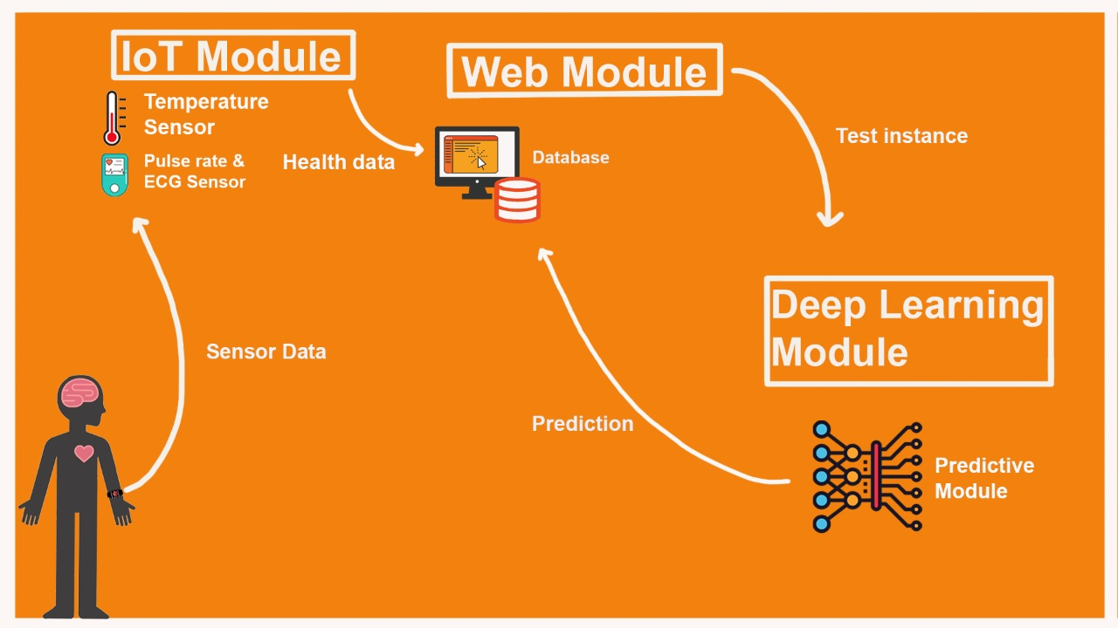
Overall Architecture

Slide 13
Project Modules (have been divided into three modules, namely, IoT, DL and Web Development.)
Internet of Things (IoT)
AI (Deep Learning) Model
Web and app Development

Slide 14
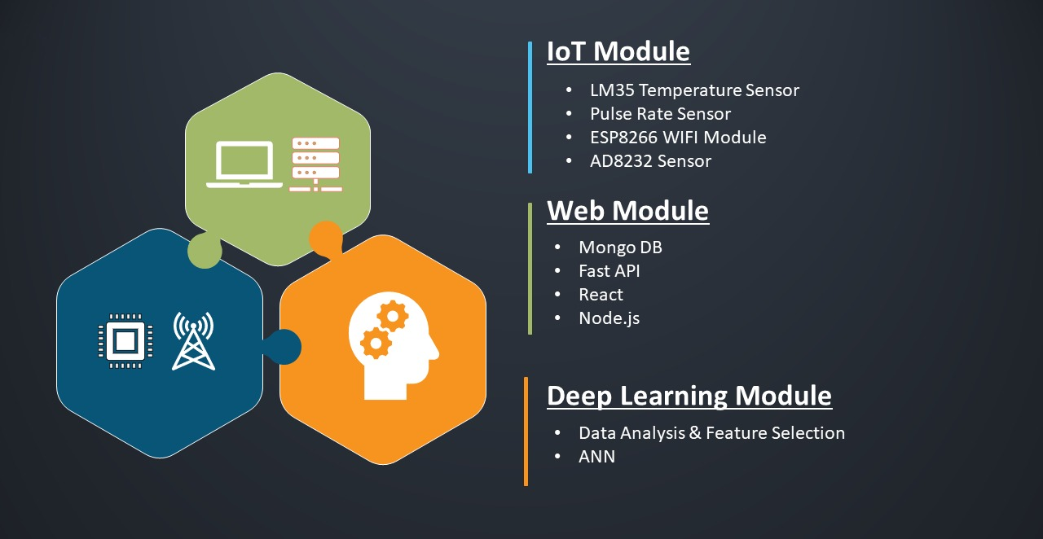

Slide 15

Module 1: IoT
The main goal of our IoT subsystem is to gather data relating to stress level calculations and send it to the website for interpretation and further processing.
The IoT subsystem is further divided into 3 parts.

Slide 16

(I)Abstraction of Data :
We will be using Arduino Uno, a microcontroller as the brain of our system.
We need to obtain various attributes in order to obtain and process the stress levels.
The various attributes we need to obtain are Electrocardiogram, Heart Rate, Oxygen Level and Temperature of the person.
The Electrocardiogram and Oxygen Level will be read using the AD8232 module.
The Pulse rate will be calculated using the Pulse Rate Sensor.
The Body Temperature of a person will be read using MLX90614 module / LM35 Temperature Sensor.

Slide 17

(II)Training the Arduino :
In this part we’ll write a suitable code for training our Arduino.
First part of the code will be for training the AD8232 module.
Second part of the code will be for training the Pulse Rate Monitor.
In the third part we’ll be training the MLX90614 module / LM35 Temperature Sensor.

Slide 18

(III)Transfer of Data :
In this part we’ll be sending the obtained data to the website.
We’ll be using the ESP8266 (Wi-Fi Module) for the transfer of the gathered data.
In order to transfer the data by the help of this module we’ll have to train this module with respect to each sensor individually.

Slide 19
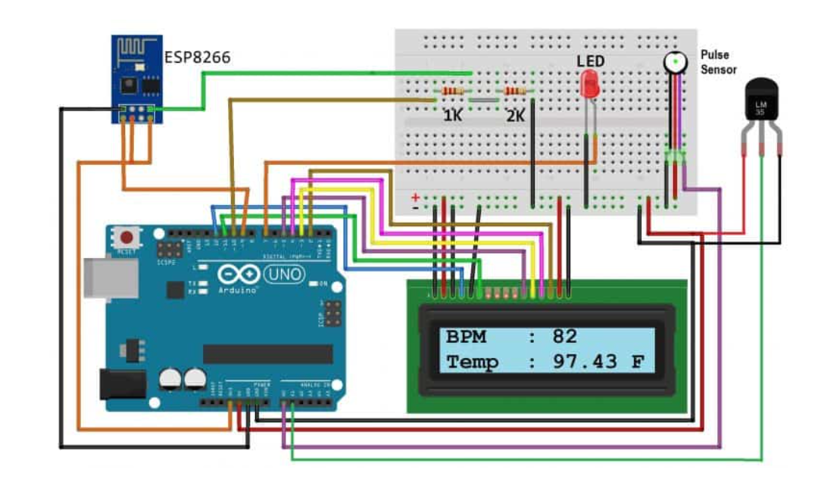
Working Principle

Slide 20
In the above circuit the following functions are taking place –
The Pulse Sensor is taking the user’s pulse rate. This is done by placing a finger firmly on top of the sensor.
The LM35 is being used for taking the temperature of a person, if the same needs to be done in a contactless manner the MLX90614 sensor can be used (it uses infrared in order to measure temperature).
The (16 x 2) LCD is displaying the body temperature reading (from LM35 - Temperature Sensor) as well as the Pulse Rate readings (from Pulse Sensor).
The ESP8266 - WiFi Sensor is being used to send the obtained data from the sensors to the Website using the TCP/IP Protocol.

Slide 21
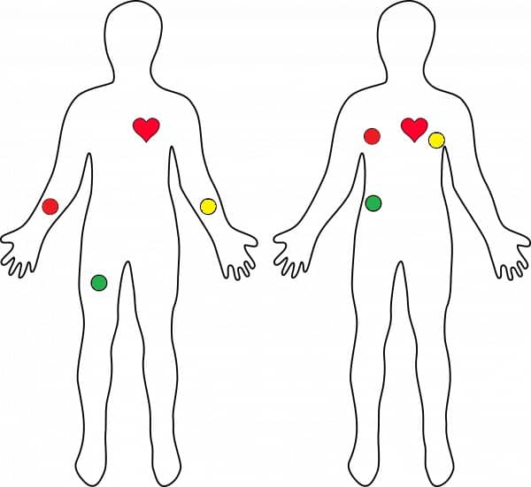
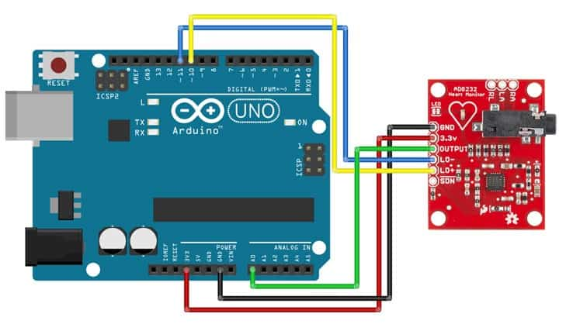
AD8232 ECG Sensor & Arduino
The AD8232 is a chip used to measure the electrical activity of the heart.
This electrical activity is known as Electrocardiogram (ECG).
Electrocardiography is used to help diagnose various heart conditions in our case it is being used to monitor the stress levels.
We’ll connect five of the nine pins on the board to Arduino.
GND
3.3v
OUTPUT
LO- and LO+

Slide 22
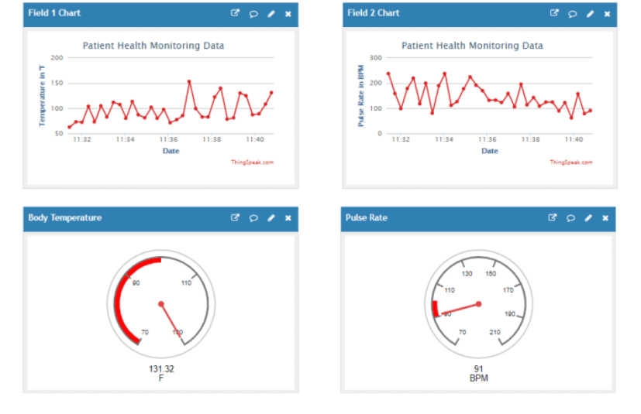
Representation of the obtained system

Slide 23
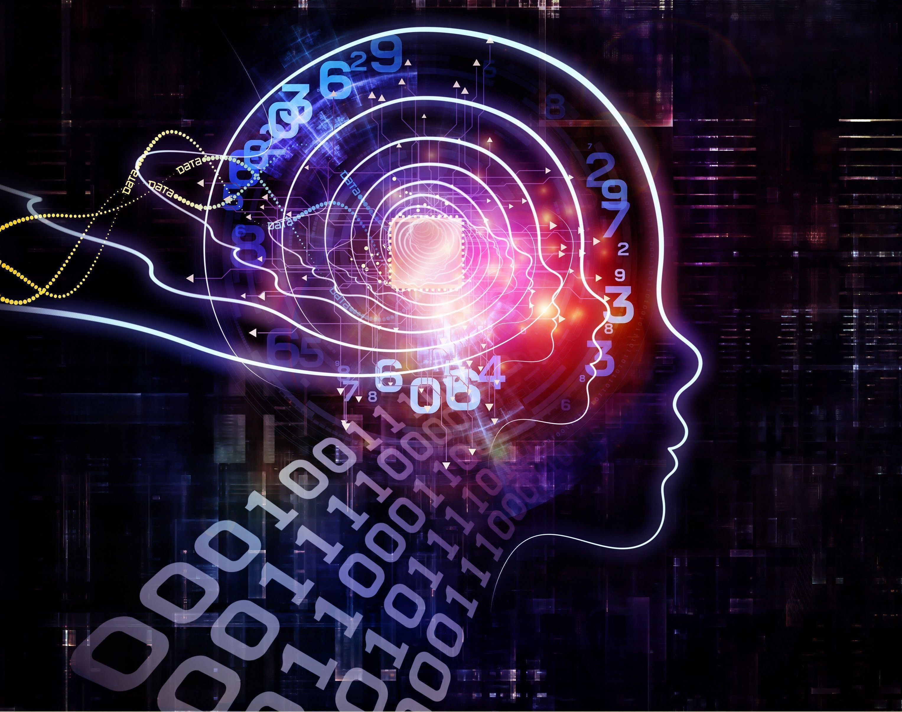
Module 2: AI(Deep Learning)Model
In the deep learning model , the libraries & technology used are as follows:
Pandas for Data Pre-processing and performing exploratory data analysis.
Sklearn ,TensorFlow for implementing neural network.
Matplotlib for plotting graphs
Python for programming

Slide 24
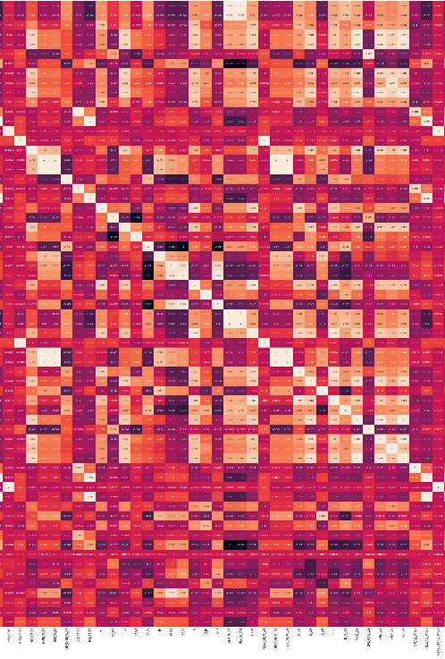
(I) Data Analysis & Feature Selection
The dataset has been checked for missing values and the data types have been altered (categorical variables have been encoded in numerics).
The target variable the condition label (whether person is normal, amused, stressed) has been encode using 8 one hot encoding.
Correlation has been used as a parameter to remove the attributes.
In addition, heatmap has been used to analyze correlation as shown.

Slide 25
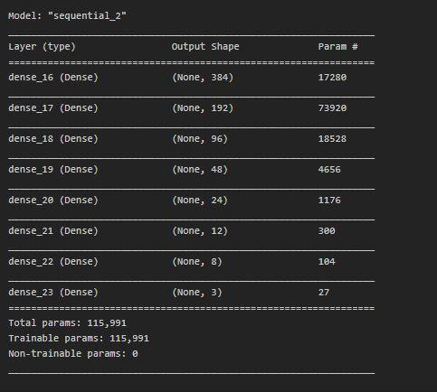
(II) ANN Architecture
We decided a architecture for ANN for first trial.
It was observed that the model was not able to learn properly over trainset and was stuck at an accuracy of 60%.
So, we added more layers in order to check whether it is due to lack of number of parameters for the dataset.
Therefore, the new architecture of ANN is as shown.

Slide 26
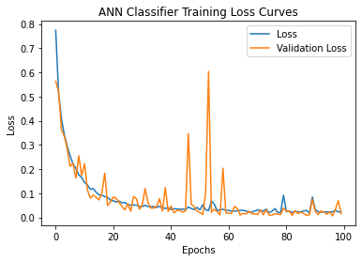
(III) Results Obtained
Results:
Training Accuracy: 99.61%
Final Training Loss: 0.0118
Test Accuracy: 99.54%
Final Test Loss: 0.0131
From the above graph we can observe that our model has trained over 100 epochs and have achieved best fit on the 100th epoch and has converged. However, this convergence can further be made smooth by trying out optimizers like RMSprop

Slide 27

Module 3: Web Development
Front-end development is essential in conveying branding to customers.
The data generated by our project should be comprehensible to the general audience. The objective of the Web and Mobile application components of the project is to translate data into results and provide it to the user swiftly.

Slide 28
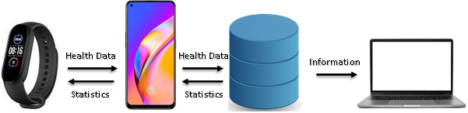
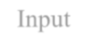
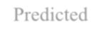
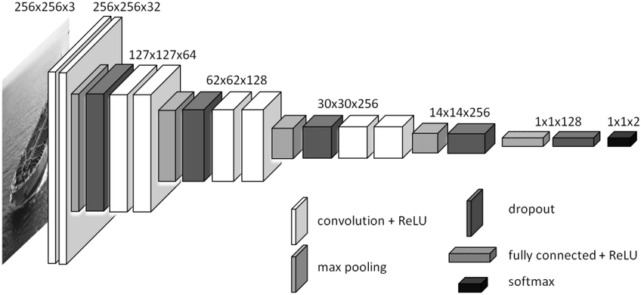
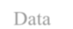
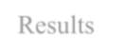
(I) Module Architecture
Input
Data
Predicted
Results

Slide 29

(II) Technology Stack
Mongo DB
Allows us to save cross-platform, document-oriented data. It uses JSON-like documents with schema, making it easier to send data to AI model.
FAST API
FastAPI is a modern, fast (high-performance), web framework for building APIs with Python 3.6+ based on standard Python type hints. It Increase the speed to develop features by about 200% to 300%, minimizes code duplication and reduces chances of development of bugs by 40%.
React
React is an open-source, front end, JavaScript library for building user interfaces or UI components. React can be used as a base in the development of single-page or mobile applications. It allows us to create our dynamic website and test our UI using JEST.
Node.js
Node.js is an open-source, cross-platform, JavaScript runtime environment that executes JavaScript code outside of a browser. It will be used for exchanging user data with UI.

Slide 30
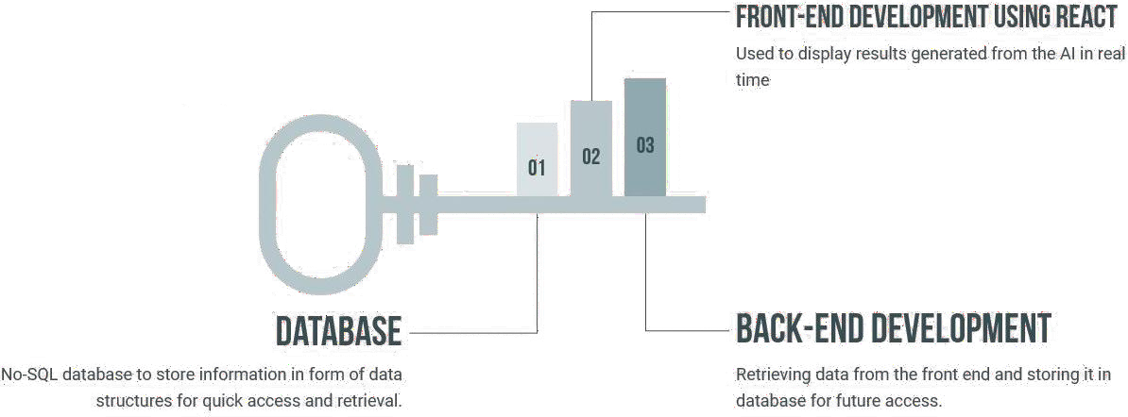
(III) Key Components
The key components are :Using EDA to allow users to understand their statistics without hassle
Using restful API to transfer information quickly
Providing the accurate data with as little change required as possible.
Providing complete information so that one can make the decision for themselves.
Creating a simple UI which causes little load on memory

Slide 31
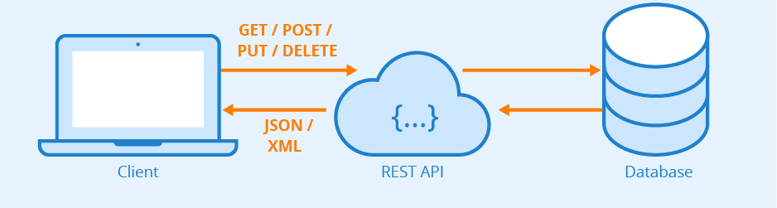
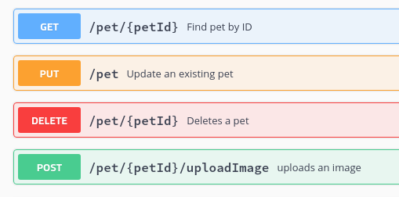
(IV)Working Principle Application Programming Interface
An API is a set of rules that enables different programs to communicate with one another.
Representational State Transfer API breaks a transaction down to generate a sequence of small components.
It uses GET to fetch data, PUT to alter the state of data, POST to create data, and DELETE methods to eliminate it.
Design Principles
Client and server should be isolated from one another.
REST APIs are stateless.
REST API design should be able to store cacheable
REST API need to have a unified interface that permits autonomous development of the application.

Slide 32
(IV)Working Principle Web Design Principles
A website’s information architecture is made up of the site’s content and functionality and structure
Steps to create a good IA
Conduct user research to understand your user
Identify business goals
Develop Content inventory
Once we have a navigation design, we need to see pages relate each other. Wireframing helps to create a simplified and schematic visual representation of a layout for digital products.
Some Design Principles Used
The Golden Ratio
Visual Grammar
Hierarchy
60-30-10 rule

Slide 33
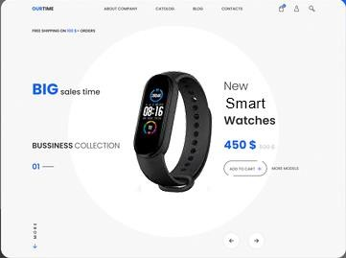
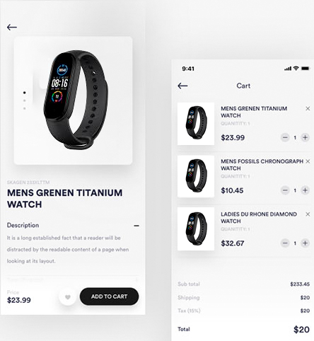
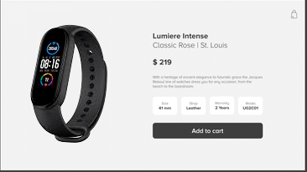
Proposed Design

Slide 34
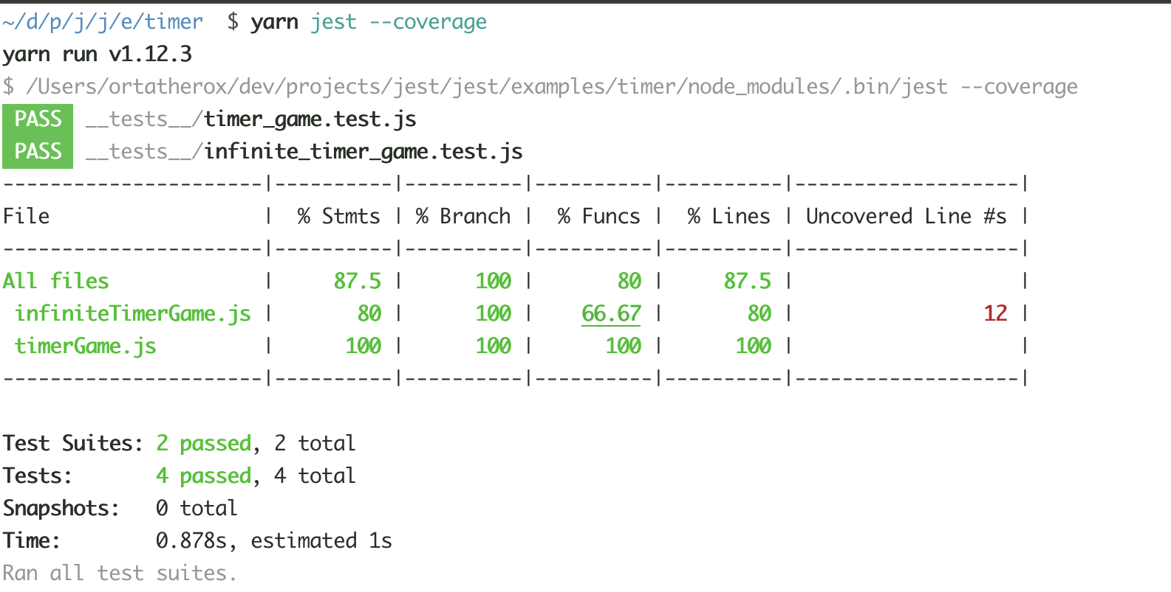
(V) Results Obtained
API Model class SearchWatchModel(BaseModel): serial: Optional[str] = None name: Optional[str] = None min_price: Optional[float] = None max_price: Optional[float] = None price_order: Optional[int] = None featured: Optional[bool] = None type: Optional[str] = None or_selector: Optional[str] = None category: Optional[List[int]] = None limit: int = 10 skip: int = 0
API Example @app.get("/v1/api/login") async def login(response: Response, email_address: str = Header(None), ip_address: str = Header(None)): user = mongodb_connection("institution").find_one( {'whiteListedIp': {'$regex': str(ip_address)}, 'whiteListedEmailAddress': {'$regex': str(email_address)}}) If instituteUser: key = encode_base64(instituteUser['_id'] + "_" + email_address) cache.set(key, "INS_" + instituteUser['_id']) response.headers['x-session-token'] = key return {'msg': 'login successful'} else: return {'msg': 'login failed'}
JEST RESULTS
Unit tests have been conducted using a mock backend. The jest result confirm that the frontend is capable of functioning in standalone mode and is ready to be connected to the backend.

Slide 35

Expected Outcomes
Identifying indicators of stress : Focus on identifying the relationship of the physiological parameters with stress and utilizing it for analysis of stress.
Enhancing current stress detection systems: Enhance this work into the development of a stress detection model by the addition of physiological parameters, including an activity recognition system and application of machine learning techniques
Multi-Modal IoT System : Developing a multimodal IoT system to gather data that we deem indispensable for stress detection

Slide 36
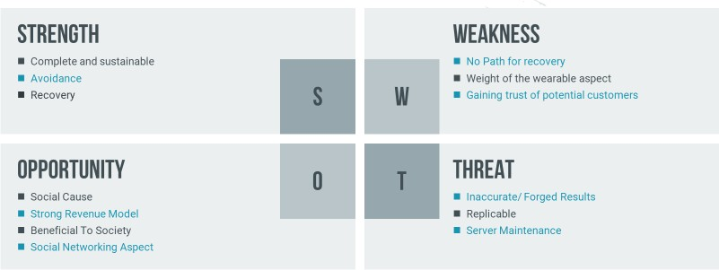
Swot Analysis

Slide 37

Conclusion
IoT technologies are being applied through many projects in the health sector. The focus however has always been on physical health rather than mental health.
The vision behind our project is to use the same methodology of detecting change in vital signs, but to use it for detecting stress.
The IoT module has been implemented and verified for its working. We have successfully chosen the basic layout of the IoT device in which the sensors required are chosen and a brief architecture of the connections has been laid out.
The dataset has been analyzed for removal of inconsistency and the feature selection using correlation as parameter the number of attributes to be used has been decreased. Acuracy have been chosen as a parameter to evaluate model.
Front end development is pivotal to the project as it deals with user interaction and helps create a brand image. The technology stack needs to be precise in order to create an efficient infrastructure that allows swift exchange of data the tech stack has been decided and their respective individual baselines have been set.
The unit test for the front-end website have been completed, using JEST library.

Slide 38

Individual Contributions

Slide 39
Module 1 : IoT
Adhyayan Bhatnagar (18BEC10002) : Formulated the workflow of the IoT team and distributed work among team members. Did the Research work on how to make an efficient IoT system along with different kinds of sensors. Worked on the AD8232 ECG sensor, Pulse Rate Sensor and the coding part for both the sensors. Worked on drafting the real time prototype. Helped in drafting the Report & presentation.
Akshit Sharma (18BCY10011) : Worked on the LM45 sensor for the ‘contact’ Temperature Sensing Scenario and drafted the code for the same. Did the Research work on how to make an efficient IoT system along with different kinds of sensors. Worked on the MLX9614 sensor for the ‘contactless’ Temperature Sensing Scenario and drafted the code for the same. Helped in drafting the Reports.
Spriha Choudhary (18BCY10102) : Worked on the ESP8266 Wi-Fi Sensor and the coding for the same. Did the Research work on how to make an efficient IoT system along with different kinds of sensors. With the help of the ESP8266 Wi-Fi Sensor worked on how the data will reach the Website from the device. Helped in drafting the Reports & final presentation.

Slide 40
Module 2 : Deep Learning
Jasroop Singh (18BCE10125): Designed and distributed the workflow of the projects. Subdivided the project into 3 modules. Created and managed the timelines of the projects. Carried out the training phase of ANN. Fine-tuned the architecture and hyperparameter values of ANN to attain maximum accuracy. Helped in Drafting the final presentation.
Pratyush Sethi (18BCE10314): Has checked the dataset for inconsistencies. Performed feature selection using correlation as a parameters. Decided initial ANN architecture with initial set of hyperparameters. Also helped in the fine-tuned document section of deep learning in the report. Decided the evaluation metric to be used for ANN.
Nivesh Ahuja (18BCE10179): Searched and compared multiple datasets to obtain this dataset (WESAD) which focusses on predicting stress with utmost precision. Helped in filtering the dataset. Done research on finding the factors which doctors use to detect mental abnormalities (like ecg, pulse rate, rr interval, etc.). Drafted the deep learning section of the report & Complied the final presentation.
Nishtha Bhatija (18BCE10178): She has done research on how rr intervals are extracted from ecg. Helped in filtering the dataset. Researched on finding the factors which doctors use to detect mental abnormalities (like ecg, pulse rate, rr interval, etc.). Has drafted the deep learning section of the report & final presentation.

Slide 41
Module 3 : Web Development
Dhruv Nandan (18BCG10041): Worked as a frontend developer on React. Created the mockup design. Ideated on different mobile designs and produced the website design for mobile and tablet view. Built the wireframe for the website and routed the websites.Learnt JEST and wrote basic unit tests to tests the standalone wireframe. Learnt native-base for react-native and ant-design for react. Developed blocks of website using the CSS-baseline for ease of handling.
Snehal Kamal (18BCE10318): Primarily worked as a frontend developer & focused on design principles and material UI baseline. Worked on react-native alongside Dhruv and completed the mockup for mobile and web-application. Worked upon improving the website using design principles.Learnt Material UI for react and developed blocks of website using the CSS-baseline for ease of handling. Came up with the base requirements for unit tests. Worked on the parts of information to be populated by the backend.
Gursimar Singh (18BCE10105): Lead the team for Web and Mobile App Development. Researched on and suggested the optimal Technology Stack. Came up with the design using Adobe XD and worked on the wireframe architecture. Primarily worked as the backend developer. Created a server less backend using FastAPI, defined its models, APIs, and deployed it using Gunicov, Unicorv and Docker. Worked upon the Architecture for communication of Information and Information Architecture for design to figure out the relationships between web pages. Extended the wireframe to add the mockup backend, and tested the wireframe using JEST. Combined the backend and frontend and handled the APIs in using AXIOS to populate data. Worked upon tensorflow.js to understand the implementation of CNN in react and proposed to implement it through API rather than locally.

Slide 42

References
Johan Bilsen. Suicide and youth: Risk factors.Frontiers in Psychiatry,9:540, 2018.
Carl F Weems, VG Carrion, BH Mccurdy, and Mikaela D Scozzafava.Increased risk of suicide due to economic and social impacts of socialdistancing measures to address the covid-19 pandemic: A forecast.Res.Prepr, 2020.
Mesquita, João, et al. "Assessing the ESP8266 WiFi module for the Internet of Things." 2018 IEEE 23rd International Conference on Emerging Technologies and Factory Automation (ETFA). Vol. 1. IEEE, 2018.
Patnaik Patnaikuni, Dinkar R. "A Comparative Study of Arduino, Raspberry Pi and ESP8266 as IoT Development Board." International Journal of Advanced Research in Computer Science 8.5 (2017).

Slide 43

References
Marković, Dušan, et al. "Monitoring System Based on IoT Sensor Data with Complex Event Processing and Artificial Neural Networks for Patients Stress Detection." 2019 18th International Symposium INFOTEH-JAHORINA (INFOTEH). IEEE, 2019.
Mustafa, Areej, et al. "Stress Detector System Using IoT and Artificial Intelligence." 2020 Advances in Science and Engineering Technology International Conferences (ASET). IEEE.
Ragav, Abhijith, et al. "Scalable deep learning for stress and affect detection on resource-constrained devices." 2019 18th IEEE International Conference On Machine Learning And Applications (ICMLA). IEEE, 2019.
Uddin, Md Taufeeq, and Shaun Canavan. "Synthesizing physiological and motion data for stress and meditation detection." 2019 8th International Conference on Affective Computing and Intelligent Interaction Workshops and Demos (ACIIW). IEEE, 2019.

Slide 44

References
Badamasi, Yusuf Abdullahi. "The working principle of an Arduino." 2014 11th international conference on electronics, computer and computation (ICECCO). IEEE, 2014.
Ruiyan, Cai. "Principle and application of Arduino [J]." Electronic design engineering16 (2012): 047.
Thomas, Salomi S., et al. "Sensing heart beat and body temperature digitally using Arduino." 2016 International Conference on Signal Processing, Communication, Power and Embedded System (SCOPES). IEEE, 2016.
Schmidt, Philip, et al. "Introducing wesad, a multimodal dataset for wearable stress and affect detection." Proceedings of the 20th ACM international conference on multimodal interaction. 2018.

Slide 45
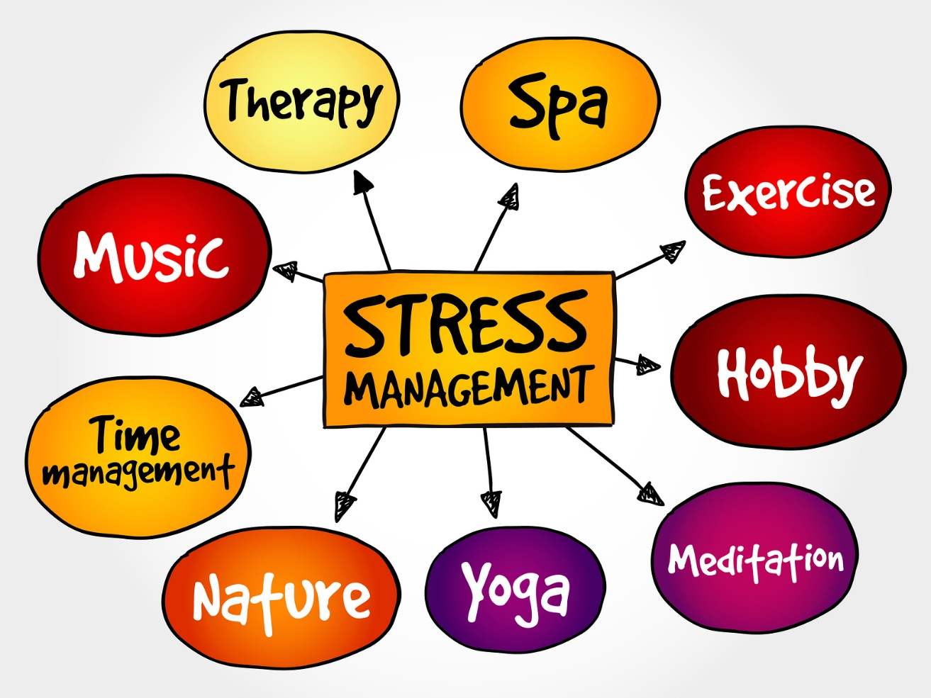
Stress is a silent killer, while everything looks fine on the outside, it keeps killing people from the inside. Let’s help everyone fight it

